Slide 1

Traditional methodology vs latest methodology
VAISHALI SC

Slide 2
Objectives
Deliver a complete and stable product through careful planning, clear documentation, and a step-by-step development process.
Follow a structured, phase-by-phase approach to reduce risks and ensure predictable project outcomes.

Slide 3
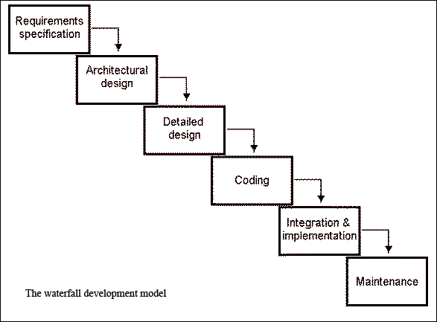
Traditional methodology
Step-by-step, structured approach to software development.
Examples:
Waterfall Model
V-Model (Verification and Validation)
Incremental Model
Spiral Model (early version)
Traditional methodology

Slide 4
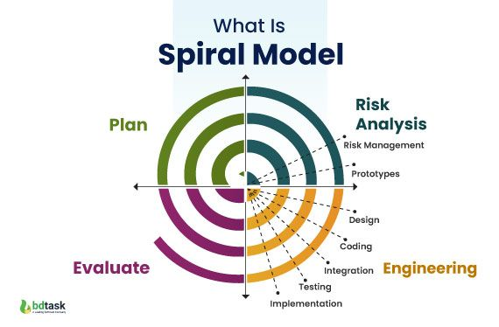
Process of traditional methodology

Slide 5

ADVANTAGES
Easy to manage (structured process)
Well-documented
Good for small, simple projects
Clear milestones and deadlines

Slide 6
DRAWBACKS
Rigid and inflexible
Difficult to adapt to changes
Late testing — bugs found late
High risk if requirements are wrong

Slide 7
Evolution from Traditional to Modern Software Development Methodologies
To overcome the limitations of traditional models like rigidity, late testing, and poor flexibility, the software industry introduced modern methodologies. These new models such as Agile, Scrum, DevOps, and Lean focus on flexibility, continuous improvement , and faster delivery of working software.

Slide 8
Latest Methodologies
Agile Model
Scrum
DevOps
Extreme Programming (XP)
Kanban
Lean Software Development

Slide 9
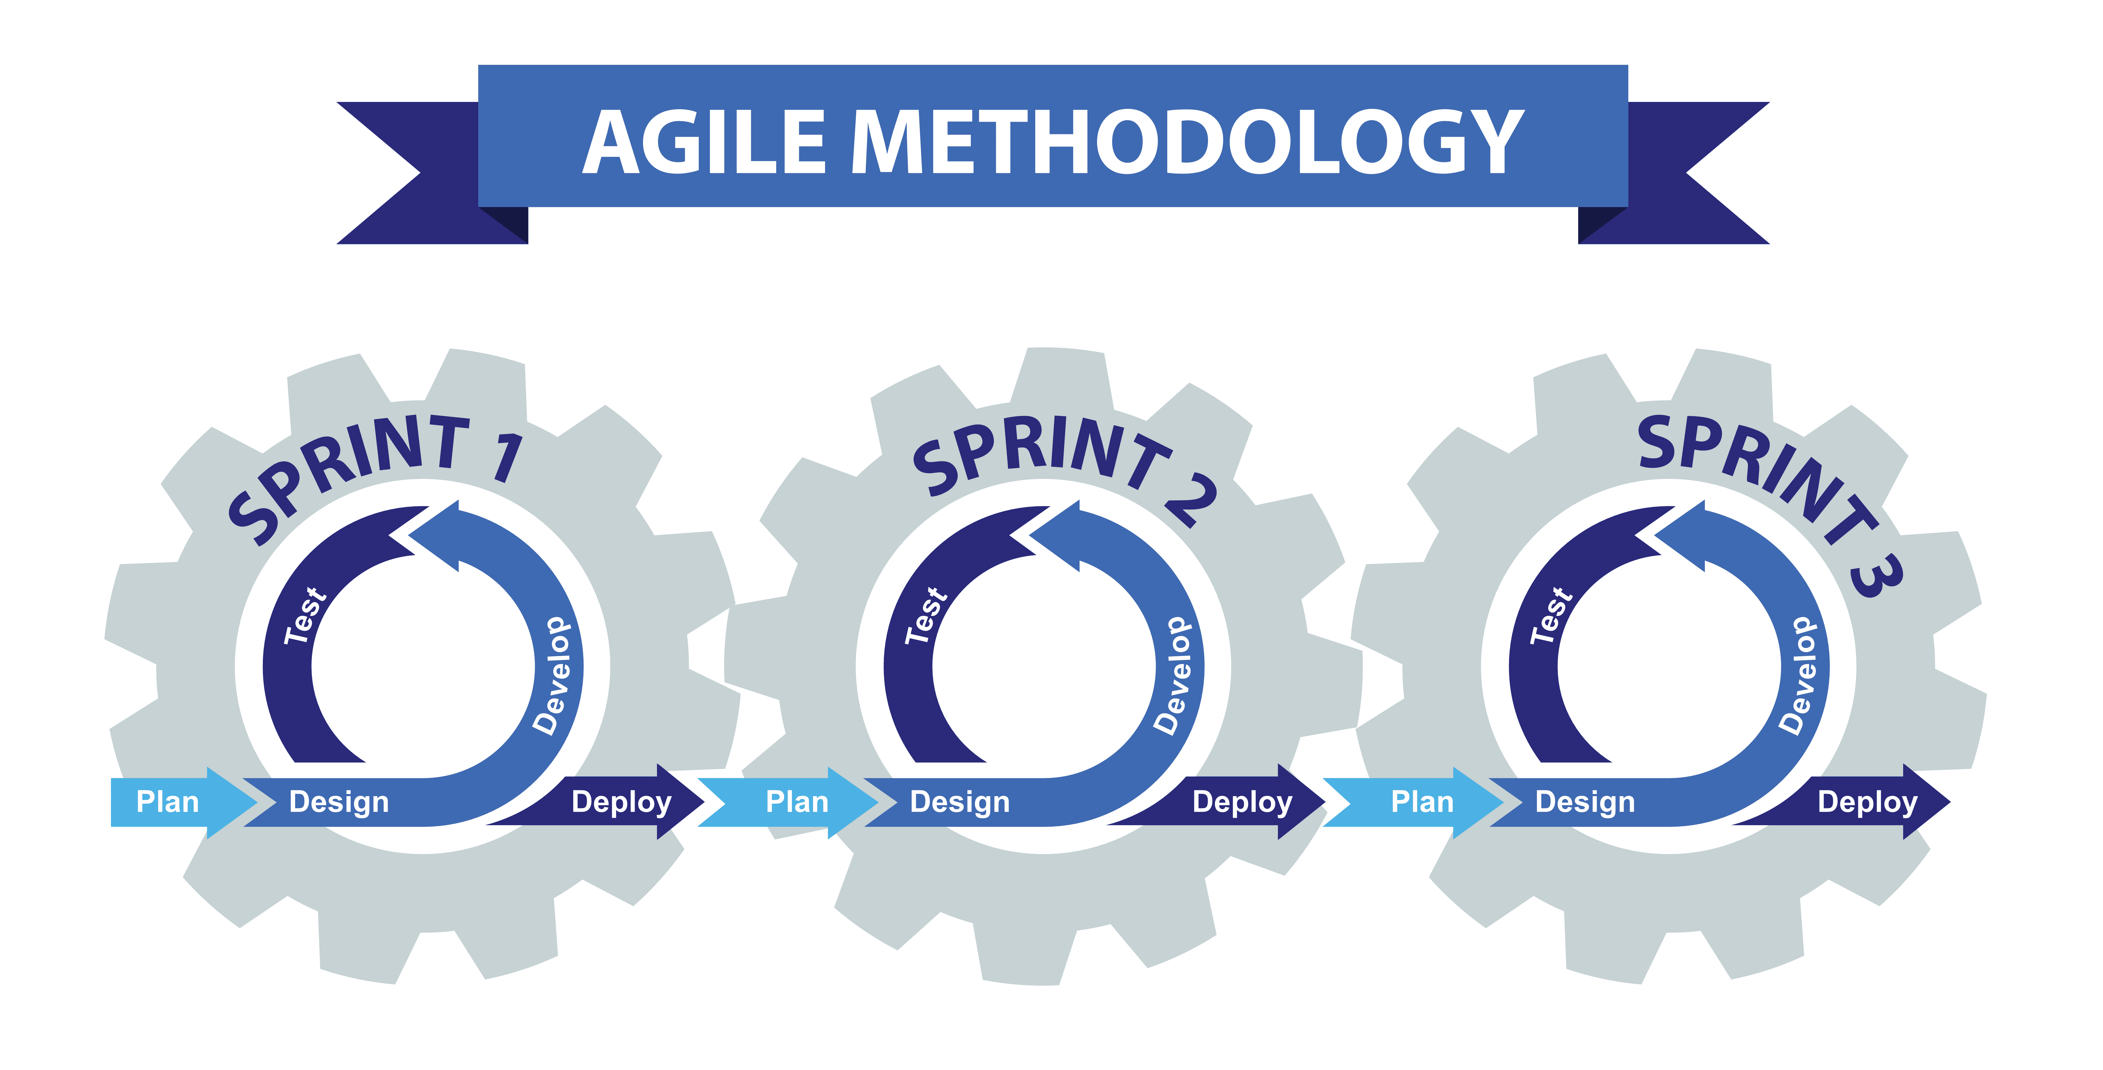
Agile Model
Agile is a flexible, iterative approach to software development. It breaks projects into small parts called sprints, where teams continuously plan, develop, test, and deliver working software. Agile focuses on customer collaboration, quick feedback, and adapting to changes easily to ensure faster and better results.

Slide 10
